Slide 1

UNIVERSITY INSTITUTE OF ENGINEERING
COMPUTER SCIENCE ENGINEERING
Bachelor of Engineering (Computer Science & Engineering)
Subject Name: Block chain Technology
Subject Code: 20_CST-412
Origin of bit coin
Mapped with CO2
Prepared By:
Er. Ankita Sharma
DISCOVER . LEARN . EMPOWER

Slide 2

Bit Coin
Bit coin is first and most widely used cryptocurrency.
Introduced in 2009 by a group of computer programmers.
It serves as a transparent and secure chronological chain of blocks containing transaction data.
Bitcoin block chain is a decentralized and distributed digital ledger that records all transactions made with the cryptocurrency Bitcoin.
“Cryptocurrency is a digital money that doesn't require a bank or financial institution to verify transactions. It’s records are maintained by decentralized structure

Slide 3
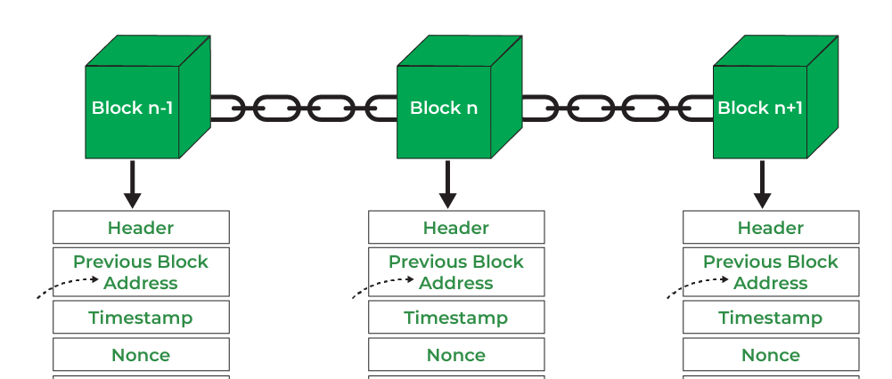
What is structure of bitcoin block chain?
A Bitcoin block records the data related to a Bitcoin transaction. The blocks are mined one after the other with all the transactions in the network being recorded permanently. Being a very secure network, the Bitcoin block chain makes it very difficult to modify or delete the data that has been registered on a block.

Slide 4
DATA
Hash Value
N O N C E
0000000ghgh4gh343g4h3g4hgghg3h4h4
Nonce(number used only once) is a number needs to be figured out such that the hash value obtained by applying
hashing function (SHA)

Slide 5
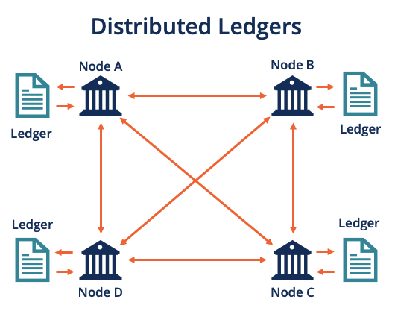
Distributed record keeping
A distributed ledger differs from a centralized ledger, the type of ledger used by most businesses. Because it provides a single point of failure, a centralized ledger is more vulnerable to cyber assaults and fraud.
With the advancement of technology, the information saved on computers is becoming cryptographically secure, quick, and decentralized. This has led to the improvement and rise of Distributed Ledger Technology.

Slide 6
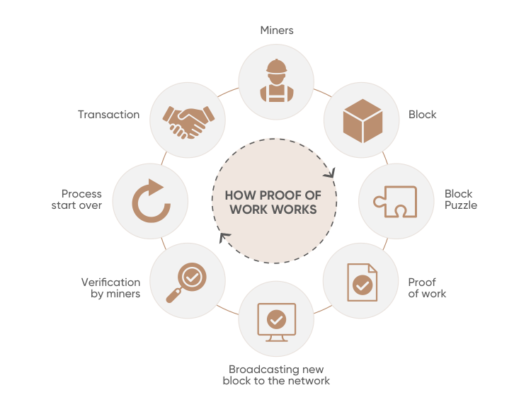
Consensus Mechanisms
Proof of work
With proof-of-work cryptocurrencies, each block of transactions has a specific hash. For the block to be confirmed, a crypto miner must generate a target hash that's less than or equal to that of the block.

Slide 7
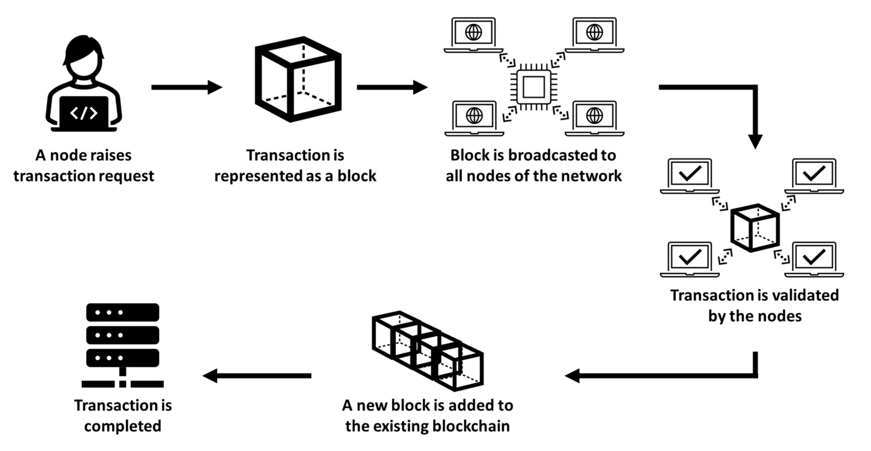
Role of a miner

Slide 8
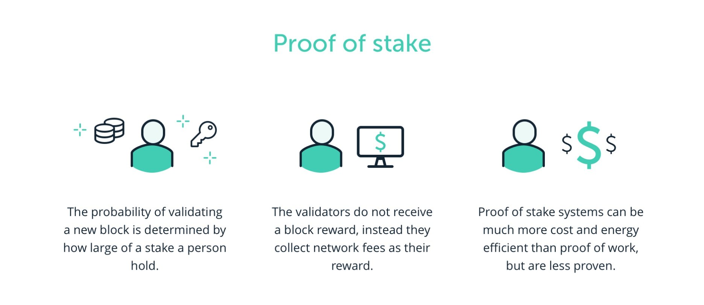
Proof of stake
In this type of consensus algorithm, instead of investing in expensive
hardware to solve a complex puzzle, validators invest in the coins of the system by locking up some of their coins as stake.

Slide 9
Difference Between Proof of work and proof of stake
S.No. | Proof of Work (PoW) | Proof of Stake (PoS)
1. | The probability of mining a block is determined by how much computational work is done by miner. | The probability of validating a new block is determined by how large of a stake a person holds (how many coins they possess).
2. | A reward is given to first miner to solve cryptographic puzzle of each block. | The validator donot receive a block reward instead they collect network fee as their reward.
3. | To add each block to chain, miners must compete to solve difficult puzzles using their computer process power | There is no competition as block creator is .chosen by an algorithm based on user stake.

Slide 10
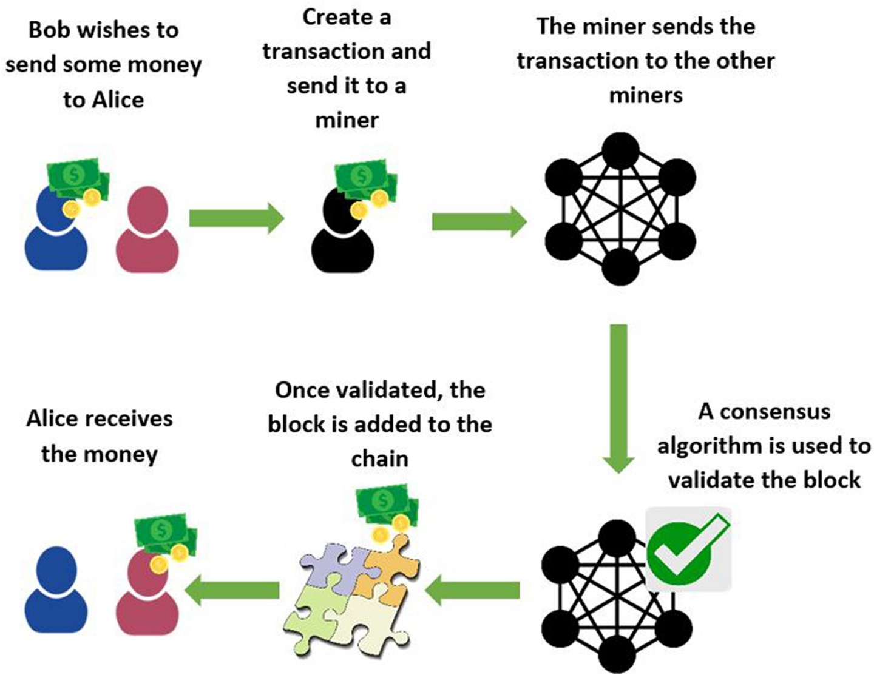
Working of Bit coin
Transactions
Verification
Block Formation
Mining
Consensus
Decentralization

Slide 11
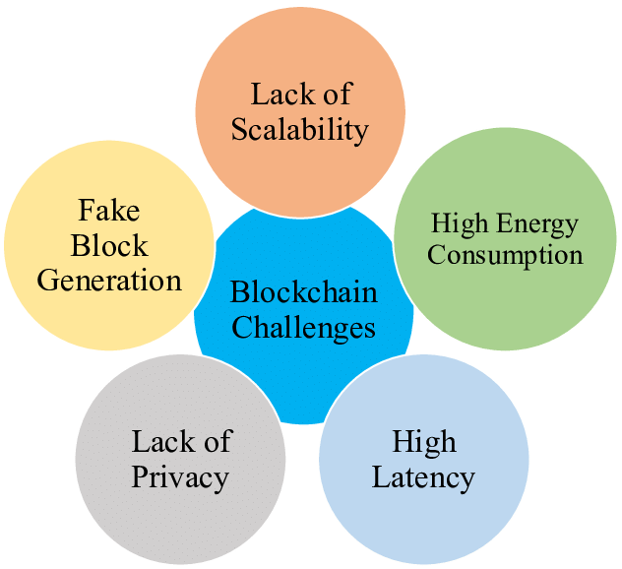
Challenges in bit coin

Slide 12
Low Scalability
With the amount of transactions increasing day by day, the block chain becomes heavy.
All transactions have to be stored for validating the transaction.
Besides, due to the original restriction of block size(1 MB) and the time interval used to generate a new block, the Bitcoin block chain can only process nearly 7 transactions per second, which cannot fulfil the requirement of processing millions of transactions in a real-time fashion.
Meanwhile, as the capacity of blocks is very small, many small transactions might be delayed since miners prefer those transactions with a high transaction fee.

Slide 13
Privacy leakage
The block chain is believed to be very safe as users only make transactions with generated addresses rather than real identity.
Users also could generate many addresses in case of information leakage.
and balances for each public key are publicly visible.
Besides, the recent study (Barcelo, 2014) has shown that a user’s Bitcoin transactions can be linked to reveal user’s information.

Slide 14
High Energy Consumption
Energy consumption is another block chain adoption challenge. Most of the block chain technology follow bitcoins infrastructure and use Proof of Work as a consensus algorithm.
However, Proof of Work is not as great as it looks. To keep the system live, it will need computational power. You probably heard about mining.
Mining will require you to solve complex equations using your computer. So, your PC will take more and more electricity to overcome this situation when you start mining.
At present, miners are using 0.2% of the total electricity. If it keeps increasing then, miners will take more power than the world can provide. Thus, it now becomes one of the primary challenges of this network.

Slide 15
Security Problems
Like any other technology, block chain also comes with a few security loopholes.
The 51% attack on the network is one of the security flaws of the network.
In this attack, hackers can take over the network and exploit it in their way.
They can even alter the transaction process and restrict other people from creating a block.

Slide 16
Lack of Adequate Skill Sets
As you know, block chain technology is relatively new and is still evolving. At the moment, few people have the skills to support such technology.
On the other hand, the demand for this qualified staff is enormous. So, if you want to hire skilled people, you’ll have to pay up large salaries. The right people will cost you.

Slide 17
Thankyou

